Slide 1


Can yr wythnos – 19/02/24 calon

Slide 2
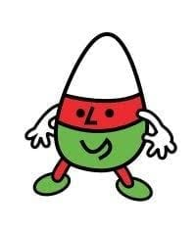

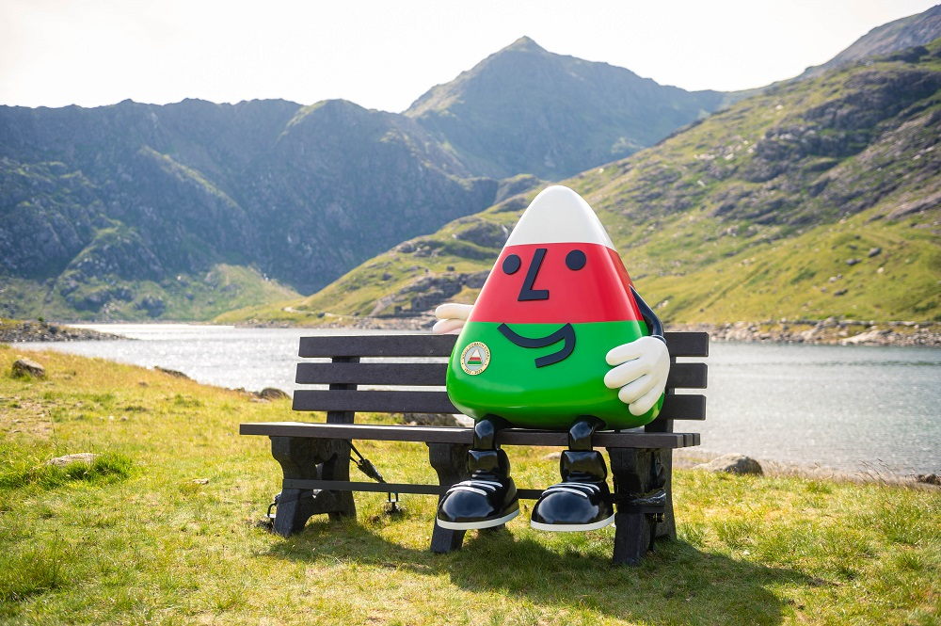
Mr urdd - 26/02/24

Slide 3
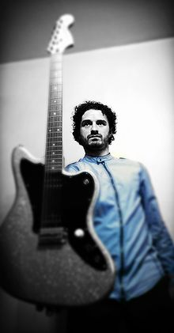



Sebon a fi! - 04/03/24

Slide 4



Yma o hyd - 11/03/24

Slide 5

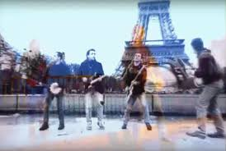

Rhedeg i paris – 18/04/24

Slide 6

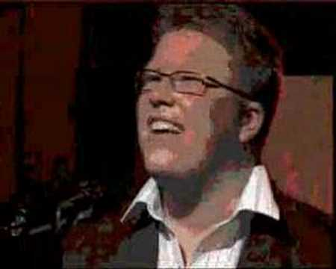
Cân ychwanegool - Sosban fach

